Slide 1
EDFD127/167
Saving a PowerPoint
As
Video
Notes:
Explain the concept of LEO as a collection of eLearning applications. Include Adobe Connect, virtual Classroom and webinars.

Slide 2
Once you have created a PowerPoint
Using PowerPoint 2010 you can save the
PowerPoint as a WMV Video File.

Slide 3
Click File

Slide 4
Click File

Slide 5
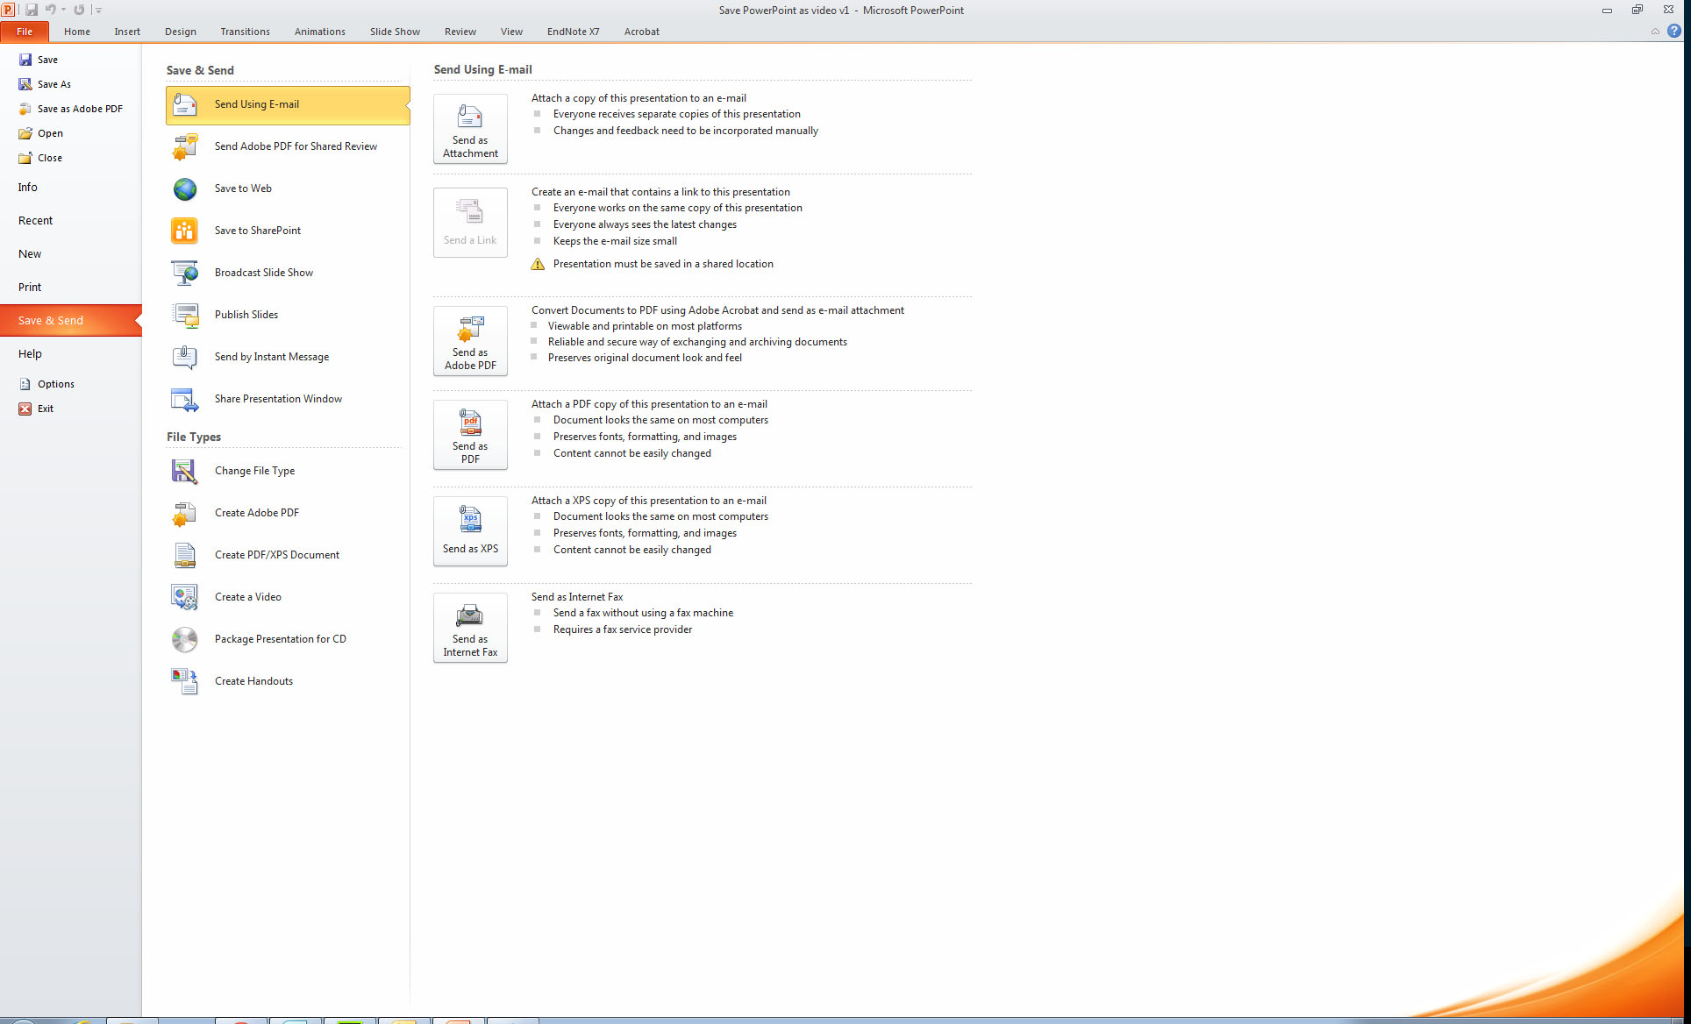
Click Save & Send

Slide 6
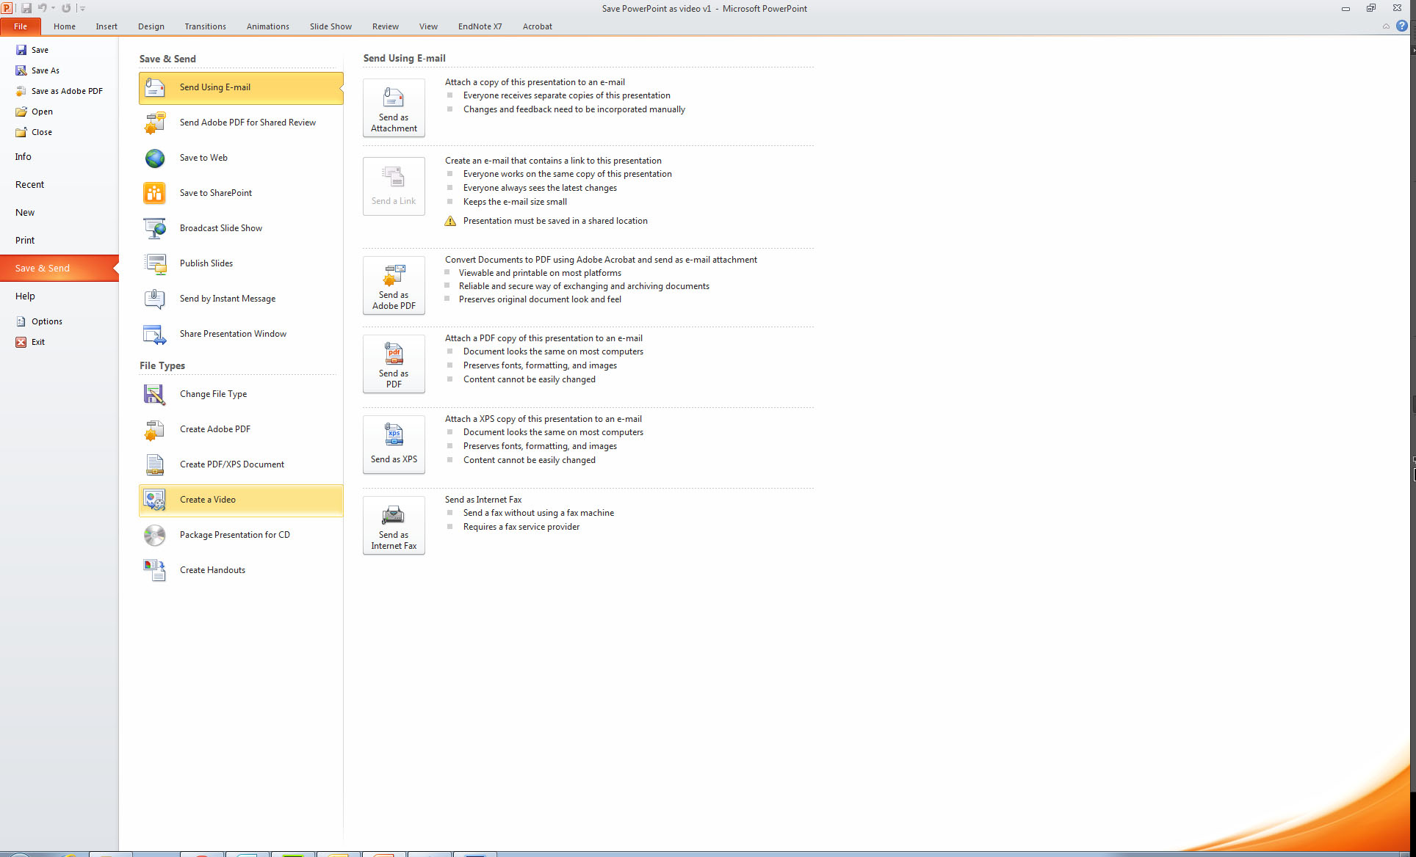
Click Create a Video

Slide 7
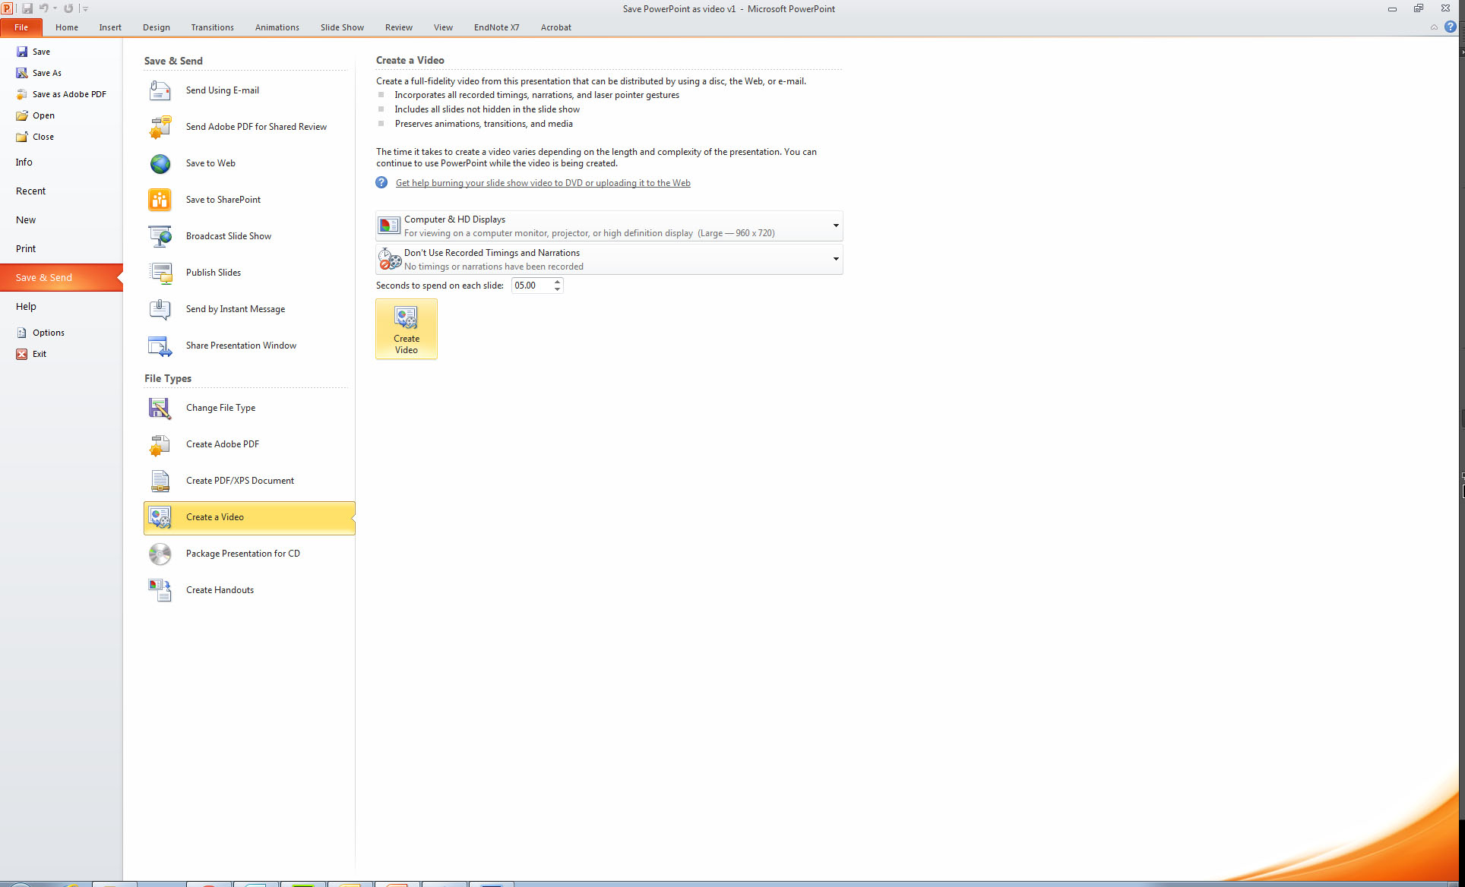
Click Create Video

Slide 8
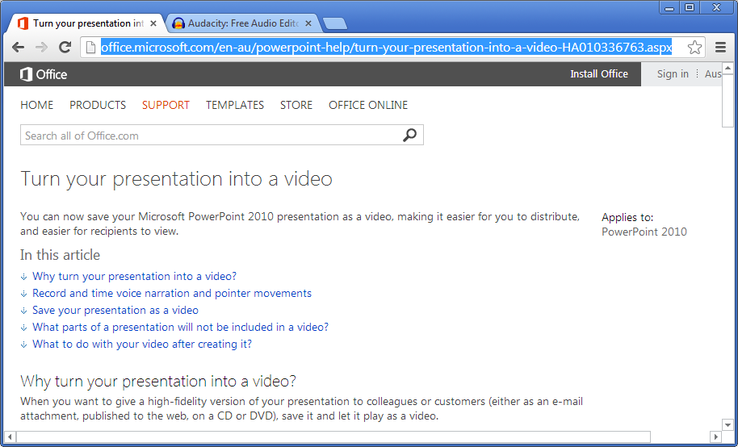
Links

Slide 9
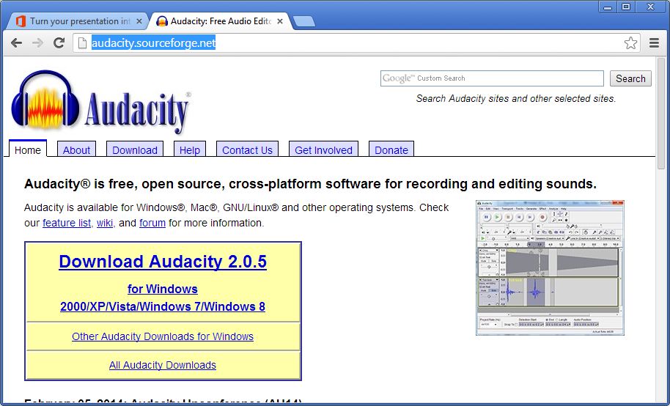
Links

Slide 10
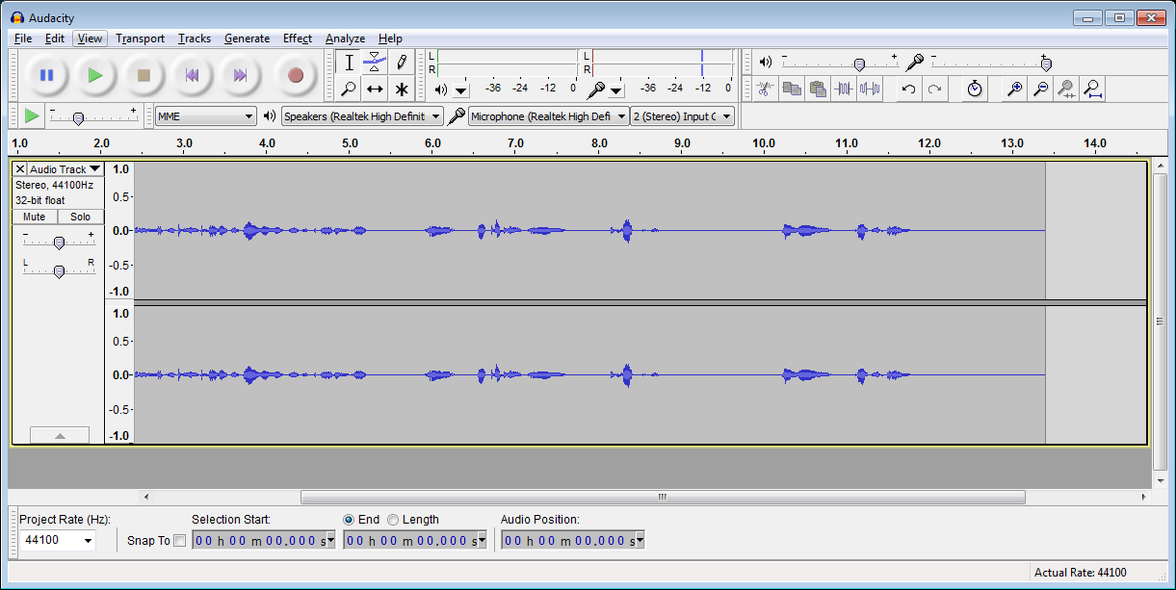
Audacity

Slide 11
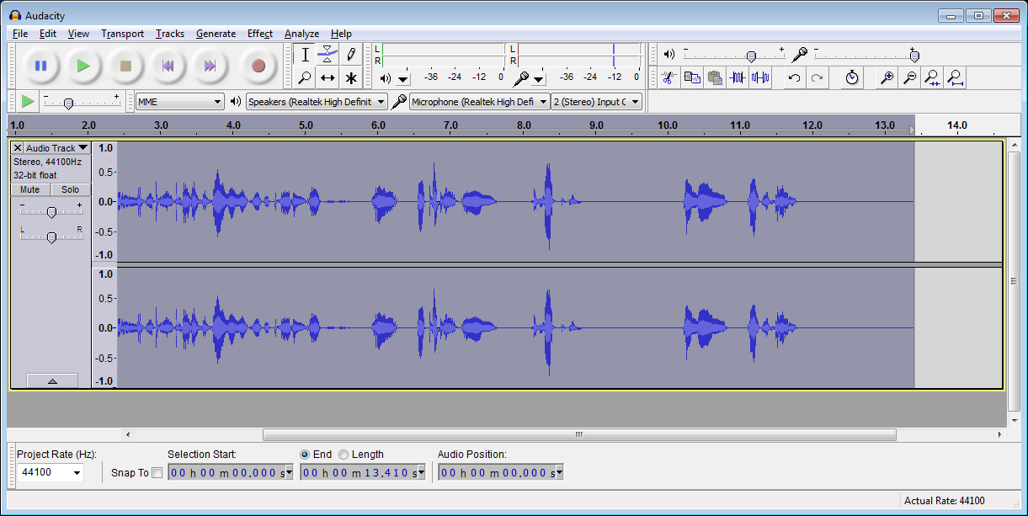
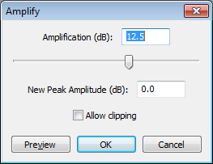
Effect – Amplify…

